Slide 1
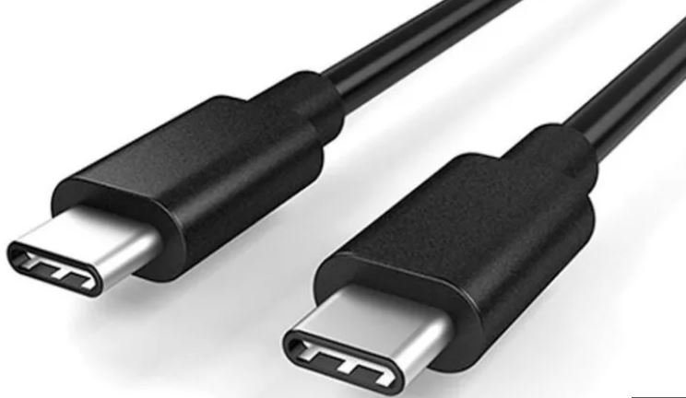
Understanding USB Technology
From Evolution to Applications
Group Members:
Kainat Jamal 2022F-BCE-200
Shahzaib Khan 2022F-BCE-160
Tayyaba Kapadia 2022F-BCE-170
Computer Organization and Architecture

Slide 2
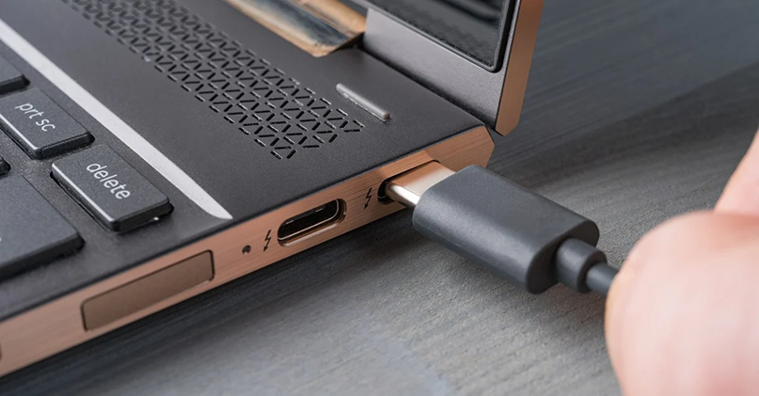
Introduction to USB
Standard for connecting peripheral devices to computers.
Allows communication and power supply between the computer and various devices.
Automatic configuration upon plugging in

Slide 3
Benefits of Serial Bus
Simplicity and Cost: Fewer wires, easier maintenance
Scalability: Supports longer distances, higher bandwidth
Power Delivery: Supplies power to connected devices
Plug and Play: Automatic device recognition and configuration

Slide 4
Historical Background of USB
1995: Development by Intel, Microsoft, IBM, and others
1996: Launch of USB 1.0 (limited adoption)
1998: Introduction of USB 1.1 (widely adopted)
2000: Release of USB 2.0 with faster speeds and battery charging
2007: Introduction of Micro connectors and USB On-The-Go

Slide 5
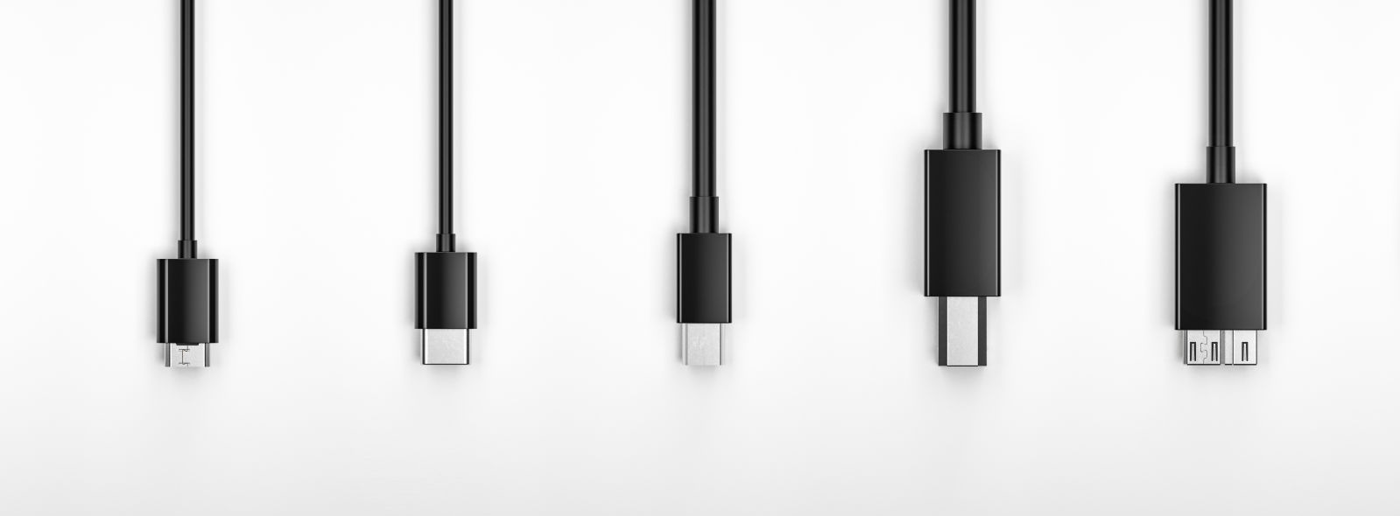
2008: Launch of USB 3.0 with SuperSpeed mode (5 Gbps)
2013: Release of USB 3.1 with Gen 1 (SuperSpeed) and Gen 2 (SuperSpeed+)
2014: Introduction of USB-C connector with higher speeds and power
2017: Launch of USB 3.2 with 10 Gbps and 20 Gbps
2019: USB4 (40 Gbps)
2022: USB4 2.0 (80 Gbps)

Slide 6
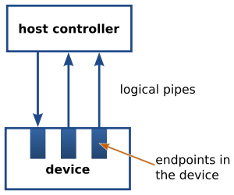
How USB Works?
Host-Device Communication:
Host signals start and stop of data transfer (frames)
Data stored temporarily at endpoints
Endpoints:
EP1IN: Receives data
EP1OUT: Sends data

Slide 7
Comparison of USB Versions (1.0 to 4.2)
Versions | Release Year | Data Transfer Speed | Key Features
USB 1.0 | 1996 | 1.5 Mbps / 12 Mbps | Basic data transfer
USB 2.0 | 2000 | 480 Mbps | Battery charging support
USB 3.0 | 2008 | 5 Gbps | SuperSpeed
USB 3.1 | 2013 | 5 Gbps / 10 Gbps | SuperSpeed+
USB 3.2 | 2017 | 10 Gbps / 20 Gbps | Enhanced efficiency
USB 4 | 2019 | Up to 40 Gbps | Thunderbolt 3 integration

Slide 8
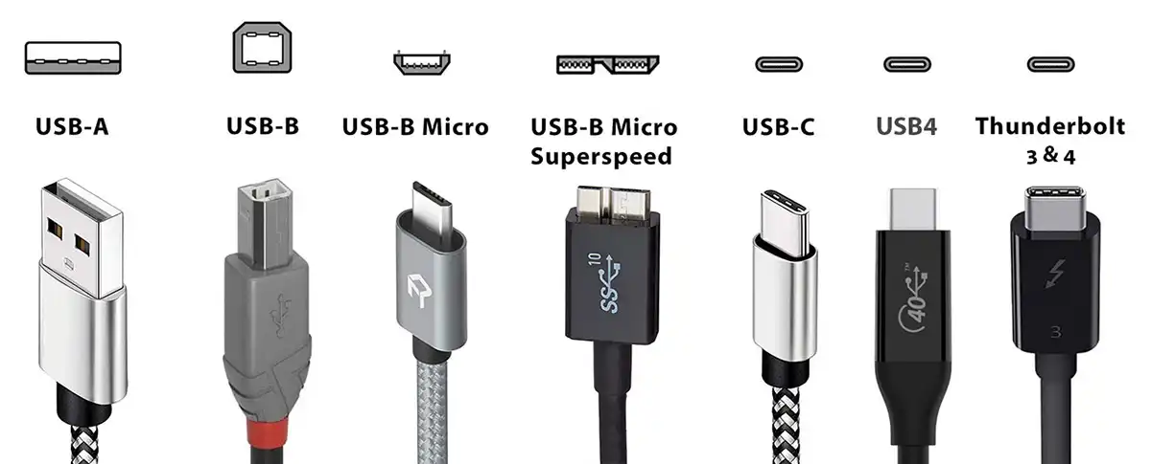
Predicting Data Transfer Rates
USB 1.0: 1.5 Mbps / 12 Mbps
USB 2.0: 480 Mbps
USB 3.0: 5 Gbps
USB 3.1: 5 Gbps / 10 Gbps
USB 3.2: 10 Gbps / 20 Gbps
USB 4: Up to 40 Gbps

Slide 9
Serial vs. Parallel Bus Protocols
Aspect | Serial Bus | Parallel Bus
Hardware Complexity | - Fewer wires, simpler hardware design. | - More wires, complex hardware configurations.
Software Complexity | - Generally simpler software protocols. | - More intricate software protocols.
Responsiveness | - Lower responsiveness due to sequential data transmission. | - Higher responsiveness with simultaneous data transmission.
Data Transfer Speed | - Initially lower speeds but increased with advancements. | - Historically higher speeds, but limited scalability.
Signal Integrity | - Better signal integrity due to reduced crosstalk. | - More susceptible to signal degradation.
Scalability | - Greater scalability for long-distance communication. | - Limited scalability due to signal integrity challenges.

Slide 10
Unique Applications of USB
1. Universal Connectivity Hub
Connects various devices (keyboards, mice, printers)
2. Power and Charging
Charges smartphones, tablets, speakers, headphones
3. Data Transfer
Moves files between devices easily

Slide 11
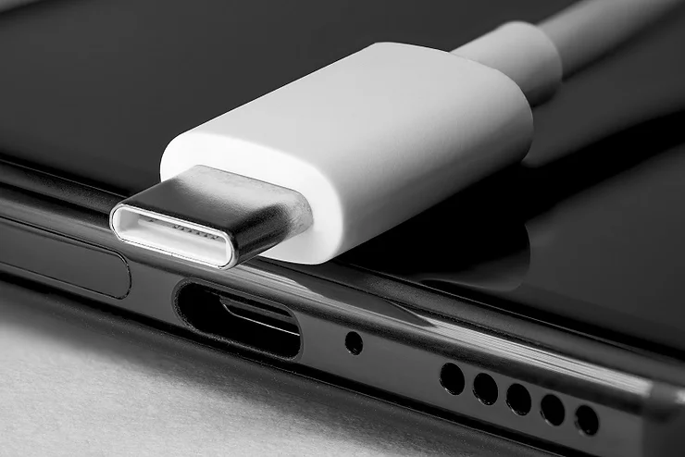
Future of USB
Increasing data transfer speeds.
Enhanced power delivery capabilities.
Greater integration with other technologies like Thunderbolt.

Slide 12
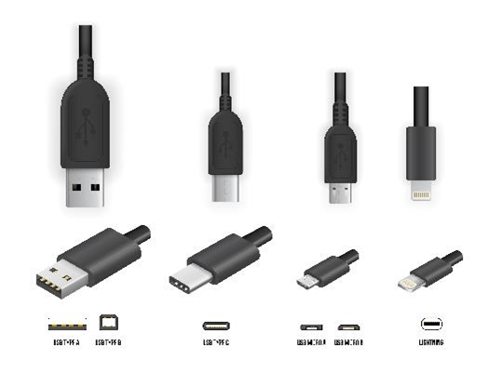
The Universal Serial Bus (USB) has evolved significantly since its inception. It has continually adapted to meet the increasing demands for faster, more efficient, and versatile connections.

Slide 13
Thank You!

